Slide 1
Step by step author instructions for institutional accounts
institutionalaccounts@plos.org; institutionalbilling@plos.org

Slide 2
Explainers:
1-page explainer
Step by step multi-screenshot walk through
Summary of four-step check process

Slide 3
To take advantage of your institutional agreement: authors must correctly identify their institutions in two places during submission
”Additional information” section
Scroll to “publication fees”
Select “Institutional Account Program” in the drop down men
Select your institution’s name from the drop down
No further steps are needed
”Manuscript data” section
In the author section, click on the pencil icon
Begin typing in the “Institution*” box
Select your institution from the dropdown
https://plos.org/publish/submit/

Slide 4
To take advantage of your institutional agreement: authors must correctly identify their institutions in two places during submission
”Additional information” and “Manuscript Data” both require correct institutional affiliation selections.
Authors can skip to any section in any order during manuscript submission process. The submission portal will alert authors when they have missed a required field. Both their payment and author personal information are required for submission.
https://plos.org/publish/submit/

Slide 5
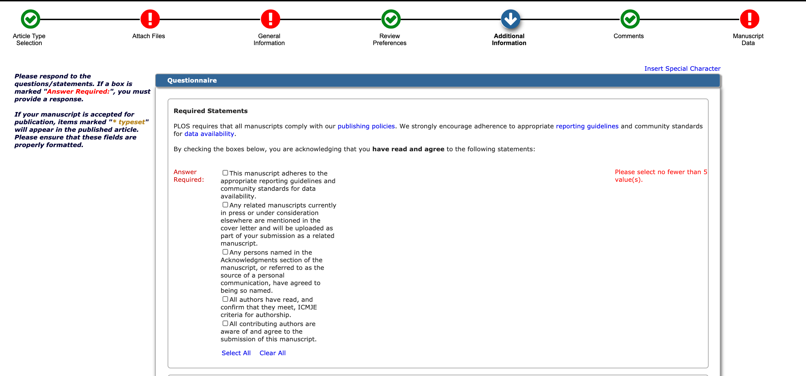
1. Click on “Additional Information”

Slide 6
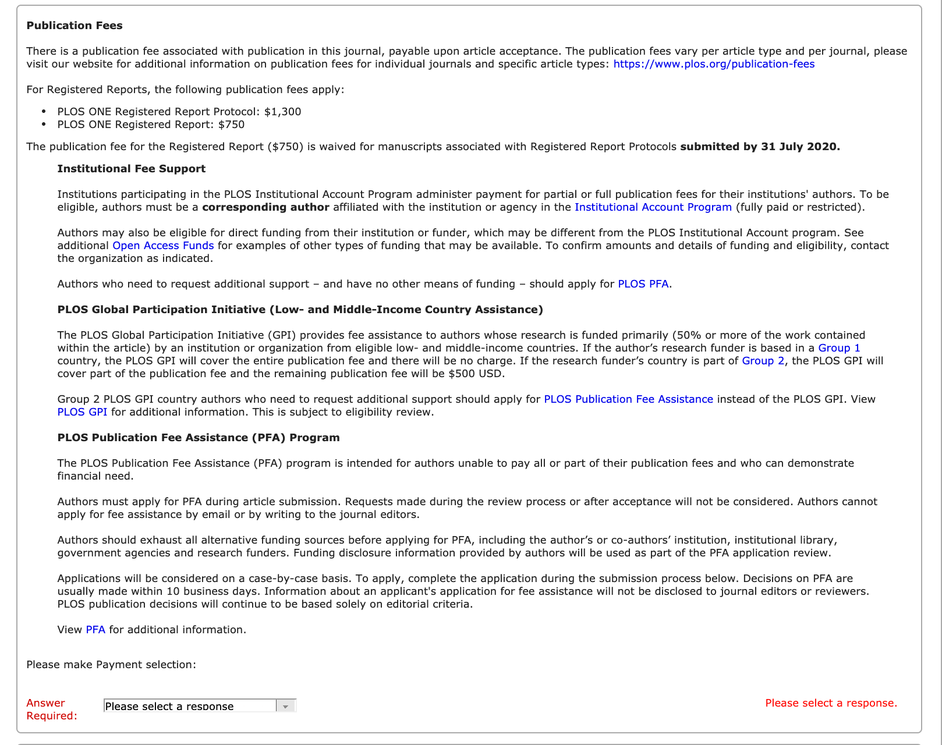
2. Scroll to “Publication Fees”

Slide 7
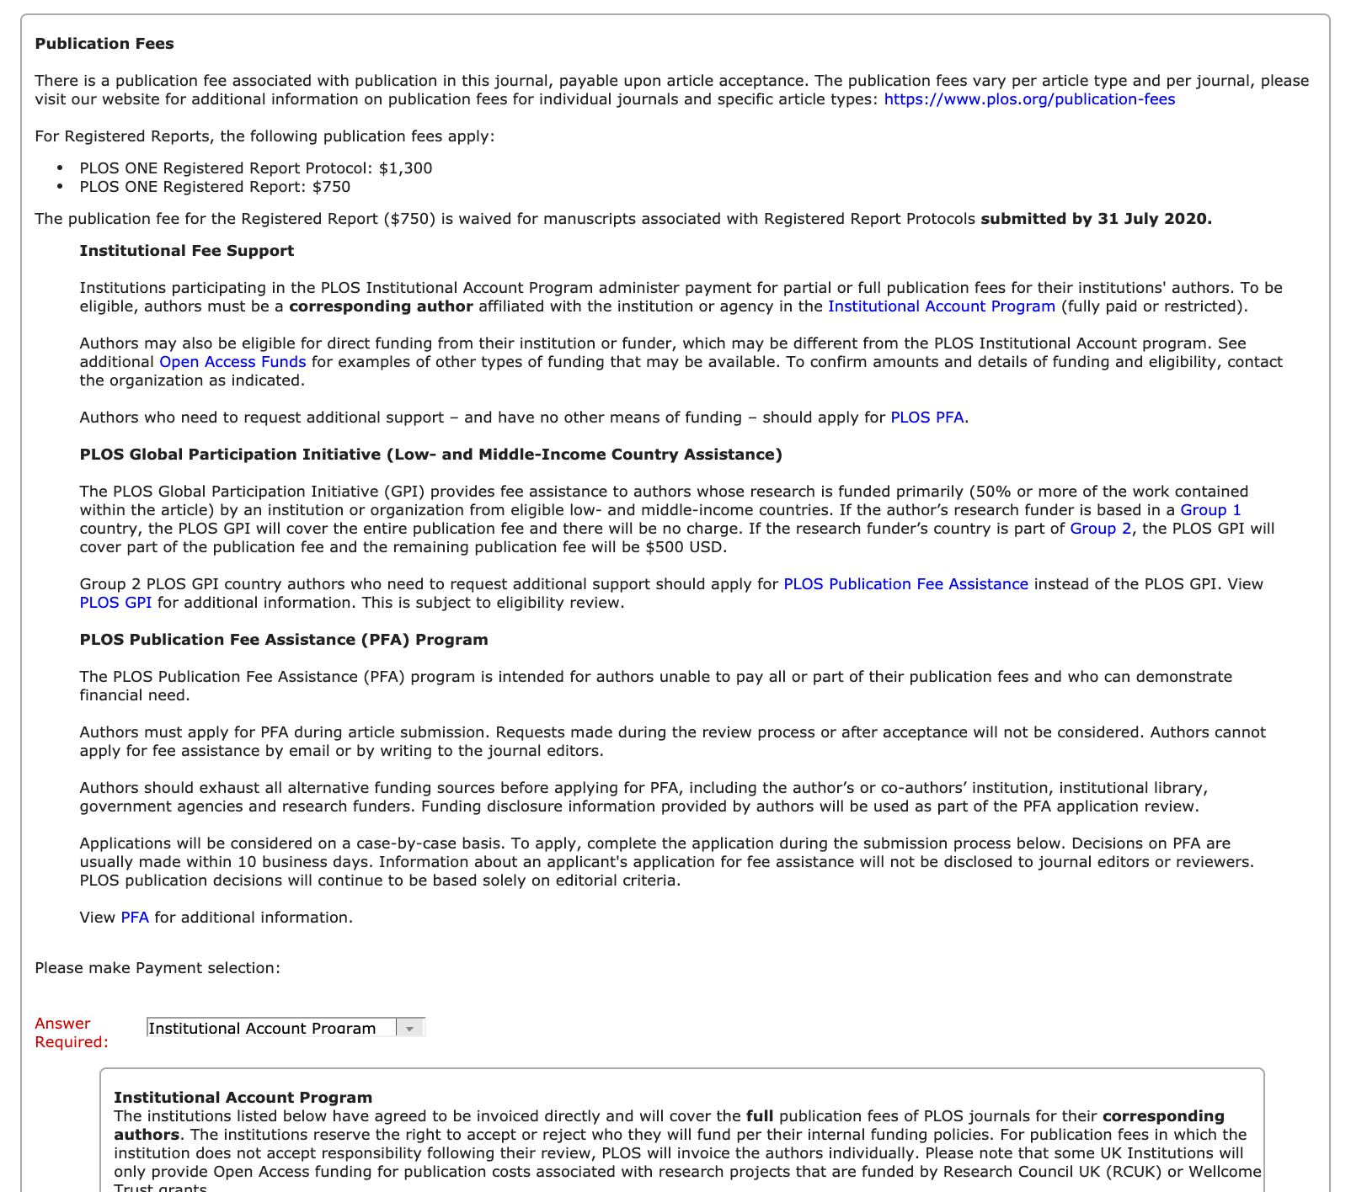
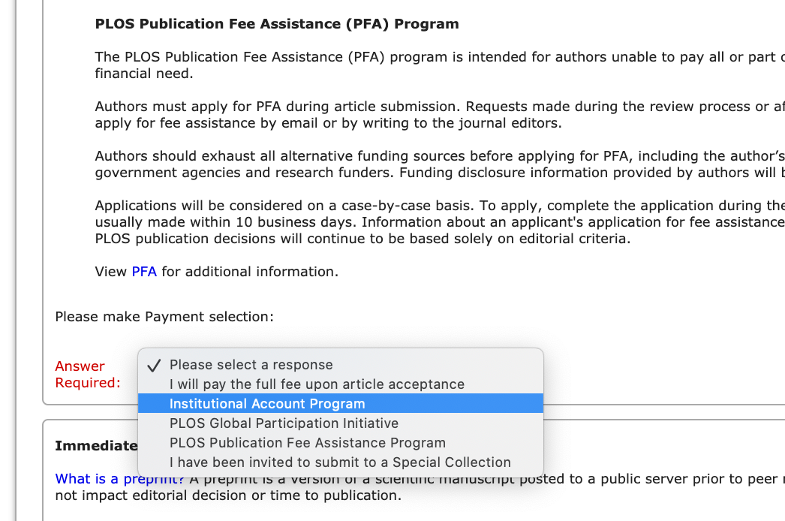
3. Select “Institutional Account Program”
In the drop down select “Institutional Account Program,” which will prompt another text box with another drop down.

Slide 8
4. Select your institution from the drop down.
Select your institution’s name from the drop down menu. Once you make a selection, no further action is required.
No more drop downs or text boxes will appear.
Complete the rest of the sections in this portion of the submission process.

Slide 9
To take advantage of your institutional agreement: authors must correctly identify their institutions in two places during submission
After completing your “Additional Information” Publication Fees selection, you will have to complete your “Manuscript Data” section prior to submission. This is where you provide all the metadata associated with your manuscript for reporting, billing, and invoicing purposes.

Slide 10
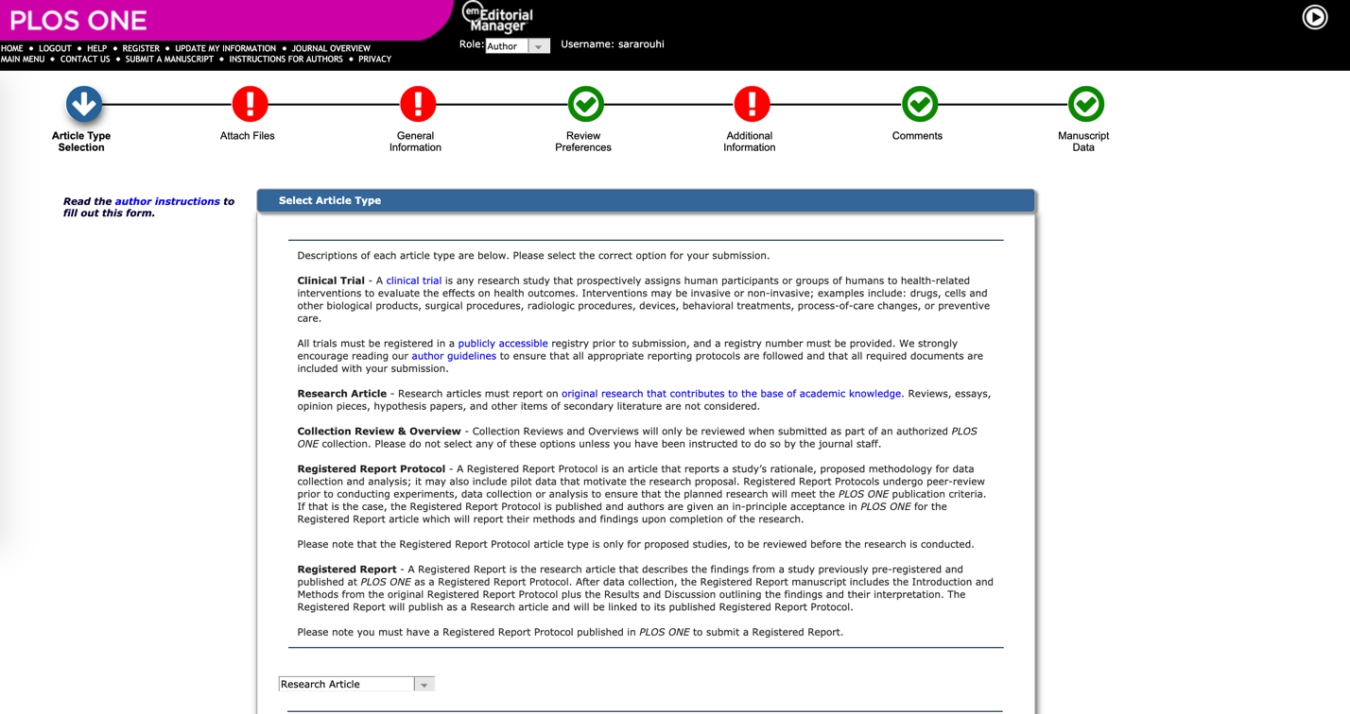
1. Select “Manuscript Data” from top-level navigation.

Slide 11
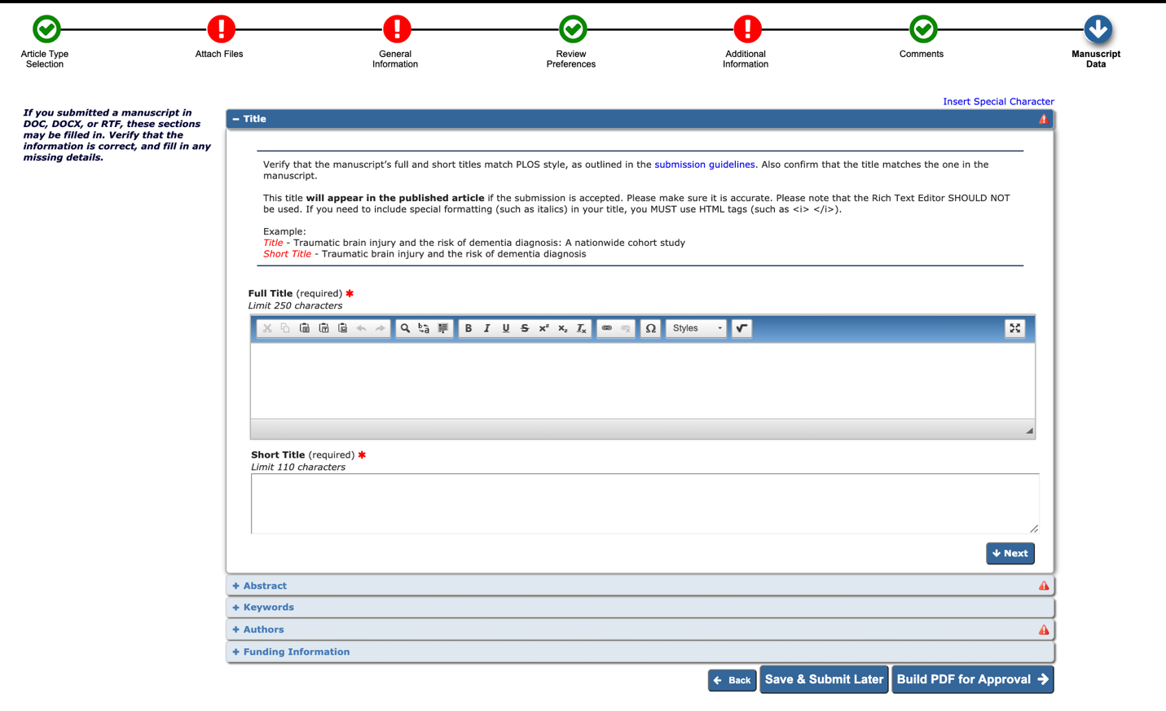
2. Click on the “Authors” drop down and provide your contact information

Slide 12
3. Click on the pencil to edit your contact information

Slide 13
3. Begin typing your institutional affiliation to prompt the drop down menu

Slide 14
4. When finished, click next and move on to providing funding information.

Slide 15
To summarize: 4 checks
Additional Information → Publication Fees → Institution Account Program → Institution Name
Manuscript Data → Authors --> Click on Pencil → Type name in institution → Click on appropriate org in drop down
There is a final institutional affiliation check done manually during the accounting/invoicing process.
The library will receive a monthly publications report where librarians can review published papers to ensure they are eligible for the library’s agreement

Slide 16
Questions?
For all journals: https://plos.org/publish/submit/
For PLOS ONE:
https://journals.plos.org/plosone/s/submission-guidelines
FAQs:
https://plos.org/publish/publishing-faqs/

